Slide 1
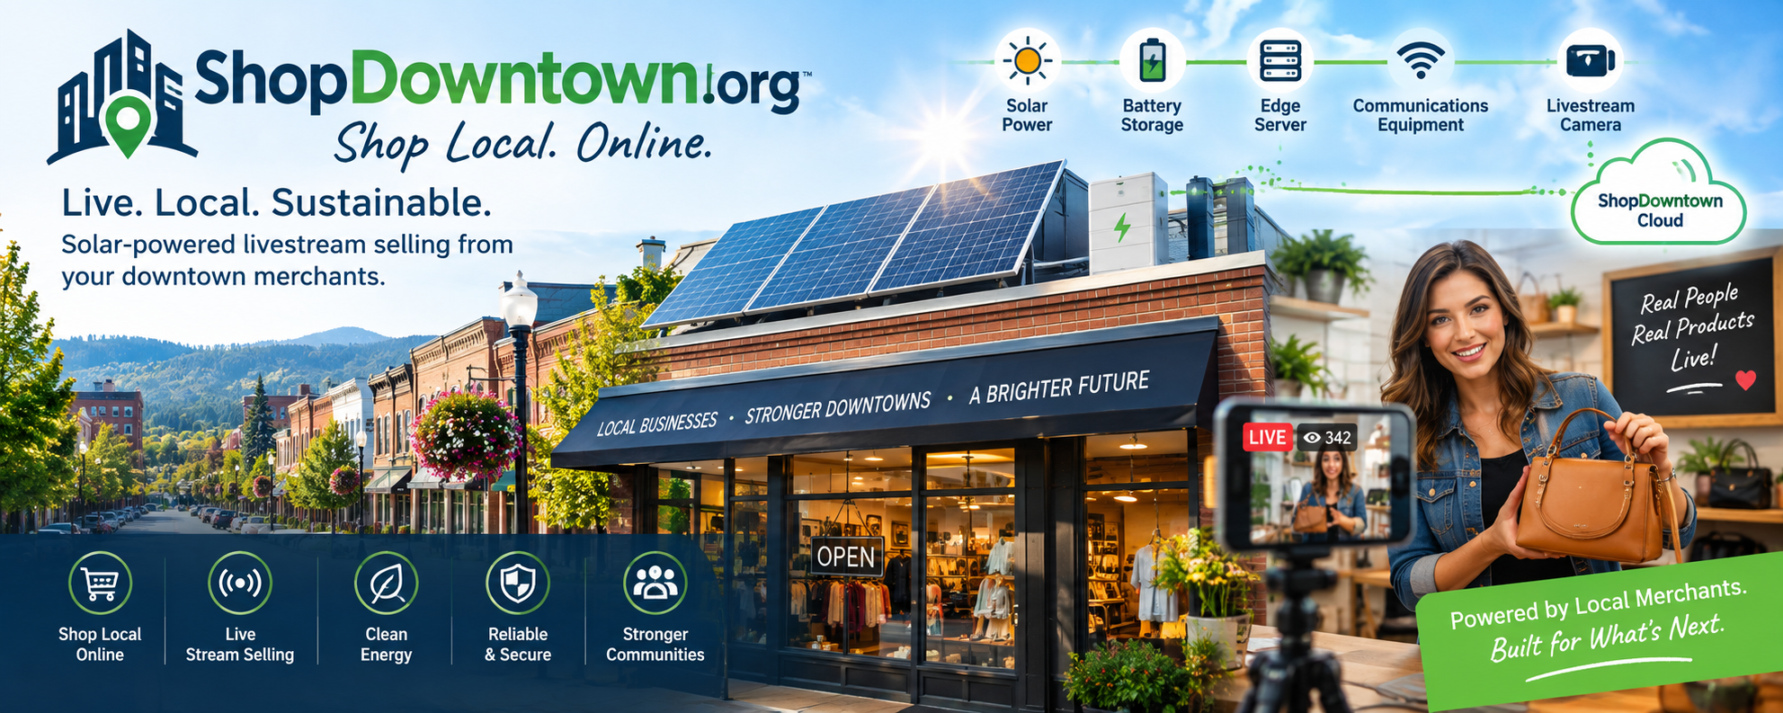

Slide 2
SHOPDOWNTOWN.ORG
The Distributed
Commerce Network
Turning participating downtown merchants into a distributed network of energy, computing, and communications nodes — and ShopDowntown into the digital infrastructure layer for downtowns.
No massive data center needed.
Prepared for CMXI.org • Daniel Wells • daniel@cmxi.org

Slide 3










THE CORE IDEA
The downtown itself becomes the infrastructure
Instead of building one centralized data center, each participating downtown business can become a small edge-computing and communications node — powered locally, connected together, and tied back to the ShopDowntown platform.
Merchant
Rooftop
Solar
BESS
Edge
Computer
Web Server /
Local Storage
Telecom
Wi-Fi
Store
Cameras
Stream
Selling
ShopDowntown
.org
“Distributed energy powers distributed computing, which powers distributed commerce.”
Fits the broader CMXI energy strategy — the same distributed-BESS thesis behind BackyardBatteries and NOxCredits.
02

Slide 4











SYSTEM ARCHITECTURE
Eleven layers, one network
Solar
BESS
Edge Computer
Generate electricity
Store electricity
Local computing / AI
Web Server
Telecom
Wi-Fi
Local services & content
Internet connectivity
Local wireless network
Cameras
ShopDowntown
Stream Selling
Store visibility
Commerce platform
Human-to-human online shopping
Marketplace
Analytics
Transactions
Measure activity
03

Slide 5


LAYER 01 · ENERGY
Distributed BESS
Each participating merchant could eventually have a small solar + battery system on-site — the power foundation for everything else the node does.
Backup power
Power for networking equipment
Power for cameras
Power for edge computing
Power for web / communications equipment
Potential demand-management benefits
Solar → Battery →
Every downstream system
Natural connection to the broader CMXI energy strategy.
04

Slide 6
LAYER 02 · COMPUTE
The edge computer
A small computer at the merchant location handles computing locally, rather than sending everything to a distant cloud.
Cameras
Video encoding
Livestreaming
Local AI
Inventory sync
Digital signage
POS integrations
Wi-Fi management
Local data caching
Store analytics
05

Slide 7
LAYER 03 · LOCAL SERVICES
A miniature ShopDowntown node, in every store
Each merchant runs a local web server with cached inventory, cameras, and Wi-Fi — all connecting back to the central ShopDowntown platform.
Store #1
Store #2
Store #3
Edge computer
Edge computer
Edge computer
Local web services
Local web services
Local web services
Camera system
Camera system
Camera system
Wi-Fi
Wi-Fi
Wi-Fi
Product / inventory cache
Product / inventory cache
Product / inventory cache
All connect back to the ShopDowntown platform
06

Slide 8
LAYERS 04–05 · CONNECTIVITY
Telecommunications & Wi-Fi
Telecommunications
Wi-Fi
Multiple connectivity options, so no merchant independently buys and configures everything:
The merchant becomes a connectivity point:
Store Wi-Fi → Downtown Wi-Fi → ShopDowntown network
Fiber
Cable
Customer Wi-Fi
Merchant connectivity
5G
IoT
Cameras
Fixed wireless
Municipal broadband
Digital signage
POS
Satellite where necessary
Eventually the downtown operates as a distributed communications network.
Edge computing
Visitor analytics
07

Slide 9
LAYER 06 · THE DIFFERENTIATOR
Stream selling
A merchant points a camera at the store or a product area. A customer anywhere on ShopDowntown.org can ask to see what's in the store — and an employee answers, live.
Customer opens
ShopDowntown.org
Merchant
livestream
Employee demos
the product
Customer asks
questions
Product
purchased
Pickup, delivery,
or shipping
Why it matters
This is human-to-human online shopping — not a static product page. It turns local ShopDowntown from a virtual marketplace into a live, personal shopping experience, powered by infrastructure the merchant already hosts.
08

Slide 10










THE BIGGER IDEA
The ShopDowntown Distributed Commerce Network™
It combines commerce, energy, computing, and communications at the local level — you don't build a data center, you build a distributed network of small nodes inside the businesses ShopDowntown already serves.
Solar
BESS
Edge Computer
Web Server
Generate electricity
Store electricity
Local computing / AI
Local services / content
Telecom
Wi-Fi
Cameras
ShopDowntown
Internet connectivity
Local wireless network
Store visibility
Commerce platform
Stream Selling
Marketplace
Analytics
Human-to-human shopping
Transactions
Measure activity
09

Slide 11
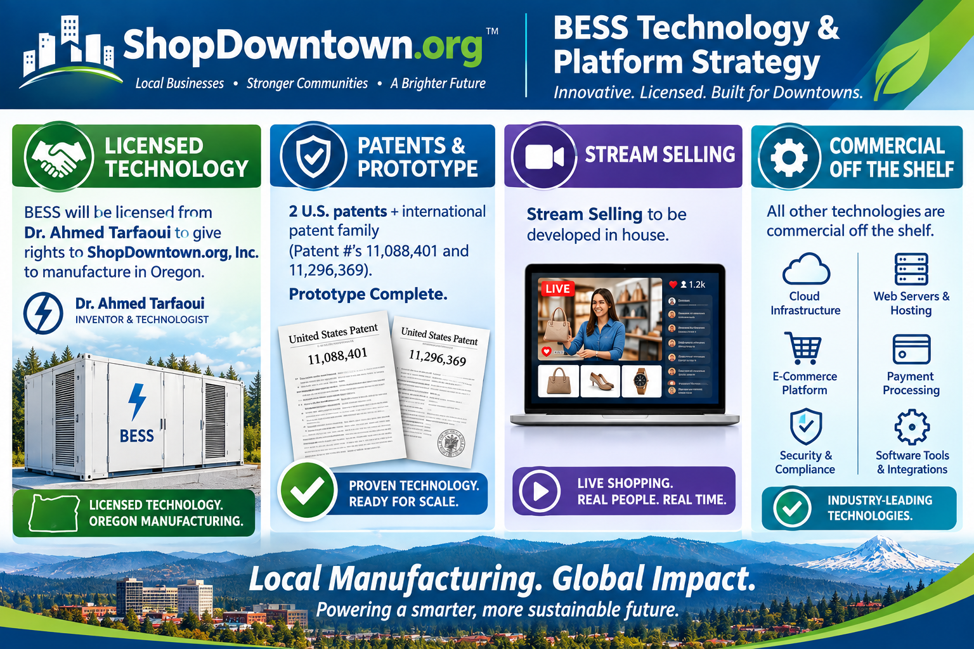

Slide 12
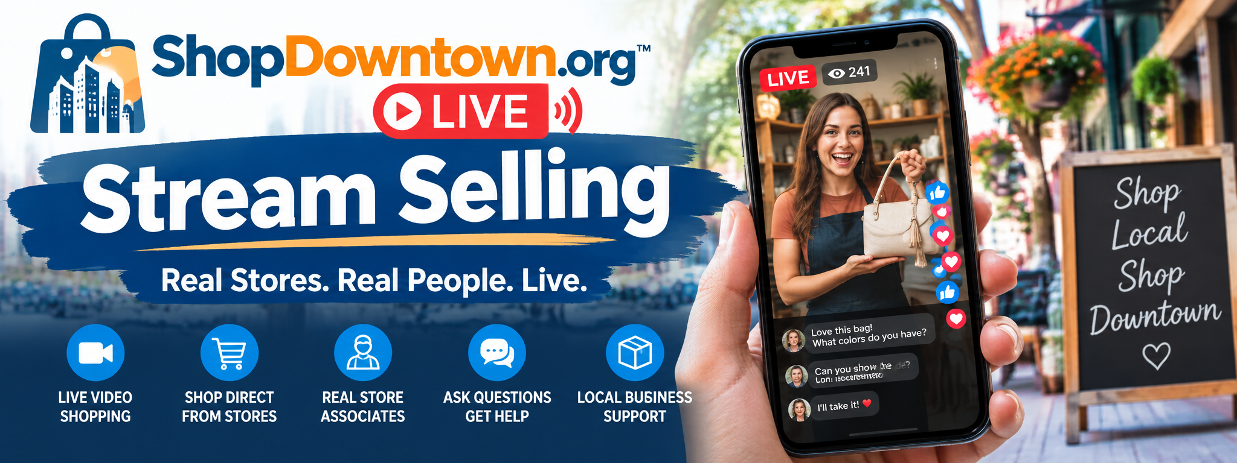

Slide 13
SHOPDOWNTOWN.ORG · PRODUCT CONCEPT
ShopDowntown Live
“Shop the Store From Anywhere”
Turning the ShopDowntown directory into a live video sales channel for every downtown store — connecting shoppers anywhere with a real clerk, standing in a real store, right now.
A ShopDowntown.org / CMXI concept brief
01

Slide 14
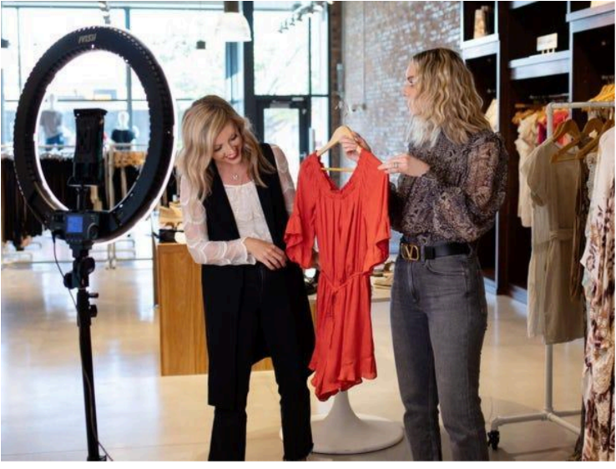

Slide 15
THE CONCEPT
Every store, a live sales channel
Every participating store has a camera. A customer visits the store's ShopDowntown page and clicks “Shop Live.”
▣
Store View
A fixed camera gives a live look at the store — open now, current vibe, who's around.
A clerk in the store answers the video call and becomes the customer's remote personal shopper.
◎
Shopping Camera
That's the shift
The clerk carries a phone or tablet and walks the floor, showing real product in real time.
From a passive directory listing → to a live, human-hosted shopping experience for every downtown business.
02

Slide 16
THE KEY INSIGHT
A salesperson, inside the customer's phone
AMAZON
SHOPDOWNTOWN
Enormous selection.
A real person, in a real store, right now.
– No one to actually ask
✓ A clerk who answers your questions live
– No feel for what's really on the shelf
✓ Shows you exactly what's on the shelf today
– Same experience in every city
✓ A completely different, local shopping experience
03

Slide 17
HOW IT WOULD WORK
Customer → ShopDowntown → Store → Clerk → Sale
1
Browse
2
Spot LIVE
3
Shop Live
→
→
Customer browses a downtown city page
Sees a participating store marked ● LIVE
Clicks “Shop Live” — camera opens into the store
4
Clerk Tours
5
Ask & Answer
6
Checkout
→
→
Clerk walks the floor, shows products in real time
“In blue?” “From the back?” “A medium?”
Buy, Reserve for Pickup, or Ship to Me
04

Slide 18
WHY IT MATTERS FOR MERCHANTS
It solves the small-business problem
Most downtown merchants don't have:
SHOPDOWNTOWN PROVIDES
✕ Professional e-commerce teams
✕ Product photographers
✕ Sophisticated websites
✕ Live-shopping departments
The technology that connects that salesperson to the world.
✕ Customer-service call centers
✕ Digital marketing departments
You aren't merely selling advertising to merchants. You're helping them generate sales — that fundamentally changes the value proposition.
But they already have the most important asset:
a salesperson standing in the store.
It moves the relationship from “we advertise for you” to “we sell alongside you.”
05

Slide 19
THE BIGGER PICTURE
A live digital window into downtown
Once cameras are live across a downtown, ShopDowntown isn't just connecting customers to a single store — it's creating a live view of the whole district, for a visitor anywhere in the world.
MEDFORD LIVE
12
3
247
Stores Live
Events Today
Products
86
14
9
Deals
Downtown Properties
Businesses Available Now
06

Slide 20
THEN ADD LIVESTREAM SELLING
QVC + local downtown + personal shopper
ShopDowntown handles the transaction end to end.
LIVE SHOPPING EVENT — 6:00 PM
“Join Sarah at downtown boutique XYZ as she shows us the newest fall arrivals.”
Product discovery
Shoppers see the newest arrivals as they come off the rack, live.
Real-time Q&A
Comments become questions the clerk answers on camera.
20, 50, or 500 people could watch. Sarah demonstrates products. Customers comment:
Built-in checkout
“I want #3.”
Every item shown is one tap from cart to purchase.
“Do you have that in large?”
Any scale
“Can you show the black one?”
20 close friends or 500 strangers — same simple stream.
07

Slide 21
THE BUSINESS MODEL SHIFT
The clerk becomes a revenue-generating employee
Suppose a downtown has 100 merchants, each with 1–3 employees trained as ShopDowntown Live Shopping Hosts:
Video Consultation
Product Discovery
Recommendation
Cart
Payment
Shipping / Pickup
Follow-up
→
→
→
→
→
→
You aren't merely selling advertising to merchants. You're helping them generate sales.
08

Slide 22
PRODUCT STRUCTURE
Three levels: Discover, Connect, Sell
FREE
PAID
TRANSACTION
Discover
Connect
Sell
– Business listing
– Live video shopping
– E-commerce checkout
– Store information & hours
– Store camera
– Shipping & pickup
– Events & deals
– Customer video calls
– Gift cards & loyalty
– Photos
– Product catalog
– Marketplace
– Downtown page
– Online reservations
– Livestream shopping
– Customer messaging
– Commission on sales
– Analytics
09

Slide 23
LOOKING AHEAD
ShopDowntown AI Personal Shopper
“I need a $100 anniversary gift for my husband. I want something unique from a downtown business.”
ShopDowntown searches participating downtown merchants, identifies appropriate products, and connects the customer with the right store — live.
↓
“John at Smith's is available now. Want me to connect you?”
That's a very different company from a traditional business directory.
10

Slide 24
IN SUMMARY
Three roles, one platform
The directory gets people there.
The live salesperson creates the relationship.
The marketplace completes the transaction.
And the cameras give ShopDowntown a way to make the physical downtown digitally accessible — from anywhere.
11

Slide 25
SHOPDOWNTOWN.ORG
Relocation Connect™
Moving to Medford? We connect you with a local real estate professional — instantly.
Relocation Intent
→
Instant Video Connect
→
Qualified Lead
→
Local Realtor
→
Referral Revenue
A local-commerce lead channel for real estate relocation revenue

Slide 26
From Click to Closing
How ShopDowntown turns relocation intent into a real estate transaction
1
Visitor Lands on ShopDowntown.org
2
Requests the Free Relocation Guide
Clicks “Moving to Medford?” and browses neighborhoods, schools, housing, and relocation resources.
Instead of a form, the visitor is offered an instant connection to a relocation specialist.
3
Instant KW Video Connection
4
KW Creates the Lead
Keller Williams' relocation team runs a live needs analysis: timing, budget, neighborhoods, and household needs.
The prospect is entered into KW's CRM and matched to the right local agent.
5
Local Realtor Joins the Call
6
Realtor Handles the Relocation
The assigned Medford-area agent can join in real time — no wait for a callback.
Home search, showings, financing, service providers, and community orientation through to close.

Slide 27
Why This Beats a Directory Page
THE OLD WAY
RELOCATION CONNECT™
Prospect → Form → Wait for a Callback
Prospect → KW → Local Realtor → Transaction
1
2
3
Higher-Value Leads
Replicable Model
New Revenue Layer
Relocation prospects carry far more economic value than ordinary directory traffic.
The same Prospect → KW → Realtor flow can be deployed in every ShopDowntown city.
ShopDowntown earns referral revenue as the originating lead-generation channel.
ShopDowntown doesn’t just help people shop locally — it helps people move, live, and connect locally.

Slide 28
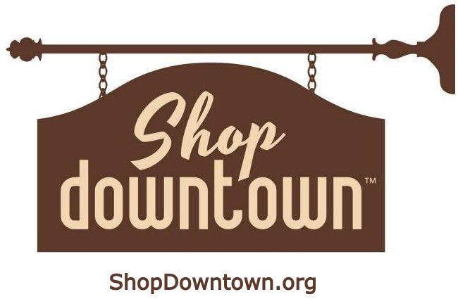
Every participating merchant becomes part of the ShopDowntown.org digital network, giving us the ability to aggregate millions of local businesses under a single domain.
This creates a scalable, high-value advertising and customer-acquisition platform where the cost of marketing the network can be distributed across the entire merchant ecosystem—strengthening traffic, engagement, data, and revenue potential as participation grows.

Slide 29


